Slide 1
Discussion today: Grating couplers
Today we will design and simulate a silicon photonic grating coupler using Lumerical FDTD

Slide 2
Silicon photonic grating coupler design
Optical fiber (not to scale)
$$\sin\left(θ\right)=\frac{n_{eff}−\frac{mλ}{a}}{n_{cladding}}$$
$$θ$$
$$x$$
$$cladding$$
$$Si$$
$$k_{mz}$$
220nm
$$a$$
$$z$$
$$SiO_{2}$$
$$Si$$

Slide 3
Silicon photonic grating coupler design
Using hand analysis we will estimate desired grating period ($a$) to achieve $θ=13°$ and use Lumerical FDTD to fine-tune the design.

Slide 4
Silicon photonic grating coupler design
What value do we use for $n_{eff}$?
This is somewhat ambiguous, we can use an average value of effective index in the “thick” region and the “thin” region of the grating.
$$n_{eff}=\frac{n_{eff,1}+n_{eff,2}}{2}$$
$$n_{eff,1}$$
$$n_{eff,2}$$
$$x$$
$$cladding$$
$$Si$$
220nm
$$z$$
$$SiO_{2}$$
$$Si$$

Slide 5
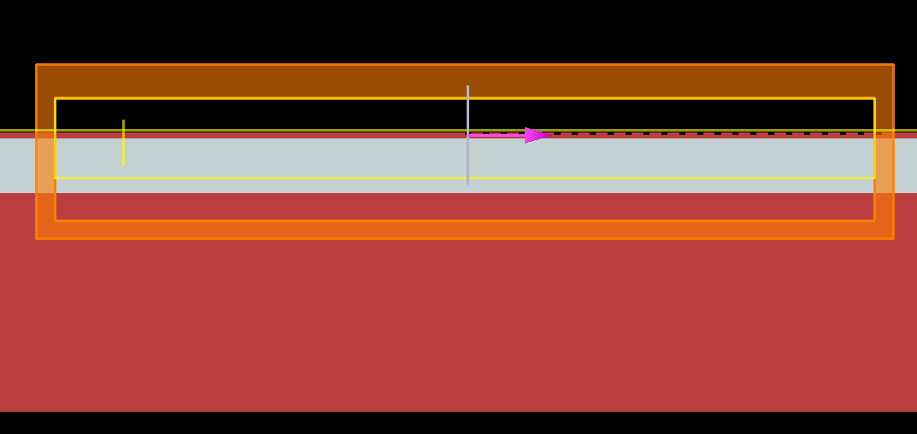
Lumerical simulation
Open disc7_gratingCoupler.fsp
To avoid lengthy simulation time, we will simulate a 2D grating
X-Y view
Mode monitor
(for coupling into WG)
Grating
Mode source
SiO₂
FDTD
Field profile monitor
Transmission monitor above grating
Si

Slide 6
Lumerical simulation
Using the mode source we will calculate the effective index in the “thick” and “thin” part of the grating.
X-Y view
Mode monitor
(for coupling into WG)
Grating
Mode source
SiO₂
FDTD
Field profile monitor
Transmission monitor above grating
Si

Slide 7
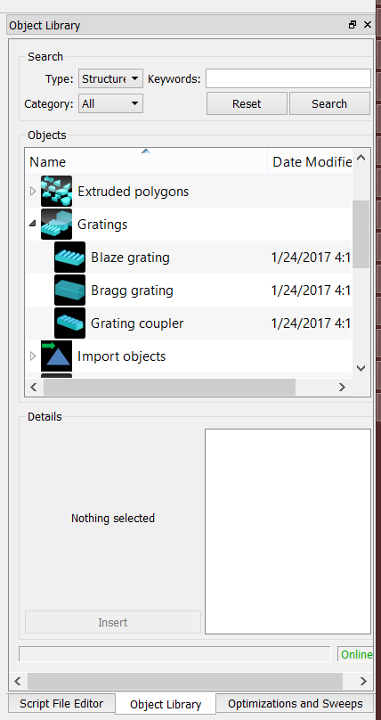
Grating coupler object
(Aside: grating coupler is created using built-in Object Library)

Slide 8
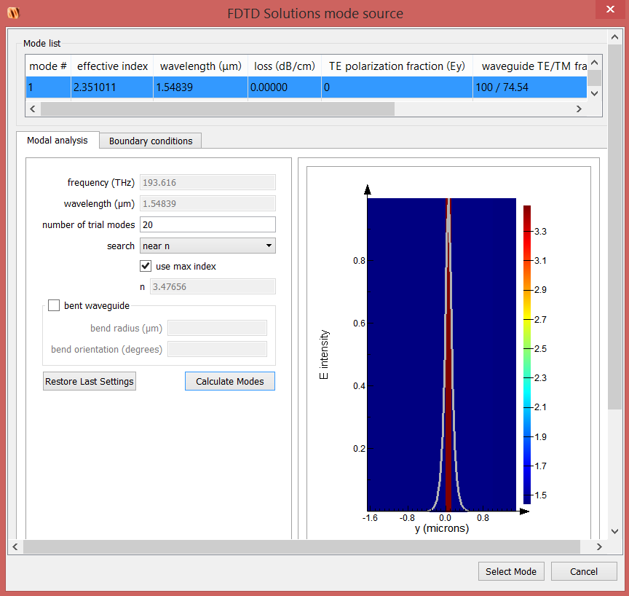
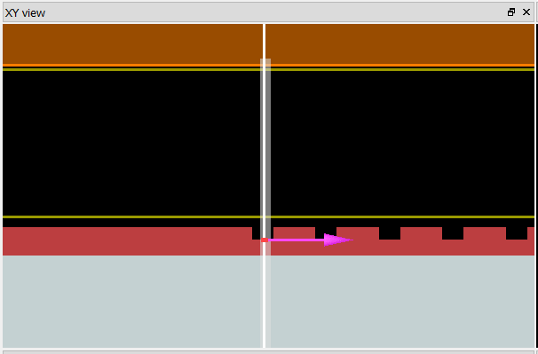
Effective index calculation (“thin” region)
Right-click waveguide_source
Click Edit object
Click Select mode
Click Calculate modes
The only guided mode has effective index 2.351

Slide 9
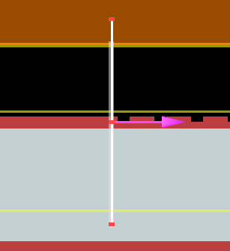
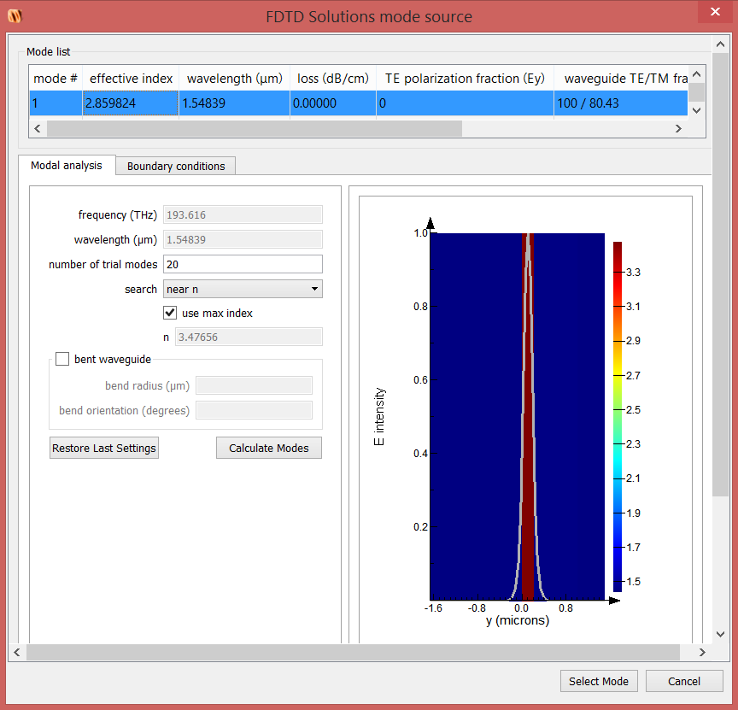
Effective index calculation (“thick” region)
Move the waveguide source to $x=−0.1$
The new effective index is 2.86
$$n_{eff}=\frac{n_{eff,1}+n_{eff,2}}{2}$$
$$n_{eff}=\frac{2.35+2.86}{2}$$
$$n_{eff}=2.6$$

Slide 10
Hand design
Design an out-coupler grating for angle of 13° at a wavelength of 1.55µm
$$\sin\left(θ\right)=\frac{n_{eff}−\frac{mλ}{a}}{n_{cladding}}$$
Note that only one order m = 1 is supported for this grating
m = 0 → $n_{eff}/n_{cladding}$ > 1 (as always)
m = 2 → 2*1.55/0.682 = 4.5 > $n_{eff}$ = 2.6
$$\sin\left(13°\right)=\frac{2.6−\frac{(1)(1.55)}{a}}{1.45}$$
$$\sin\left(13°\right)=\frac{2.6−\frac{(1)(1.55)}{a}}{1.45}$$
$$\sin\left(13°\right)=\frac{2.6−\frac{(1)(1.55)}{a}}{1.45}$$
$$a=682 nm$$

Slide 11
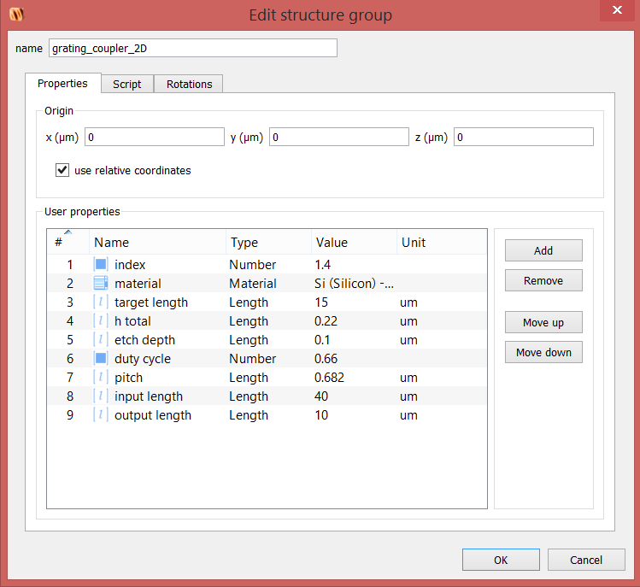
Change grating period (pitch)
Right click on grating_coupler_2d and click Edit object

Slide 12
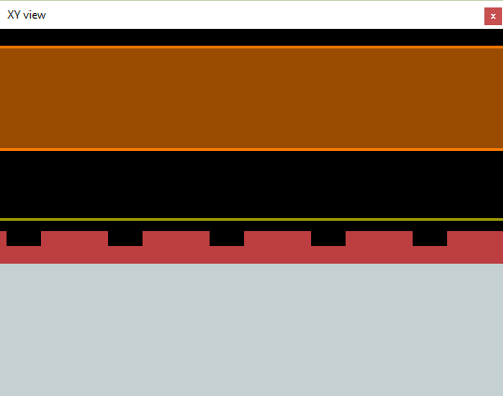
Field monitor above grating
We wish to monitor the power transmitted out of the grating
Right click aboveMonitor and select Edit Object
monitor

Slide 13
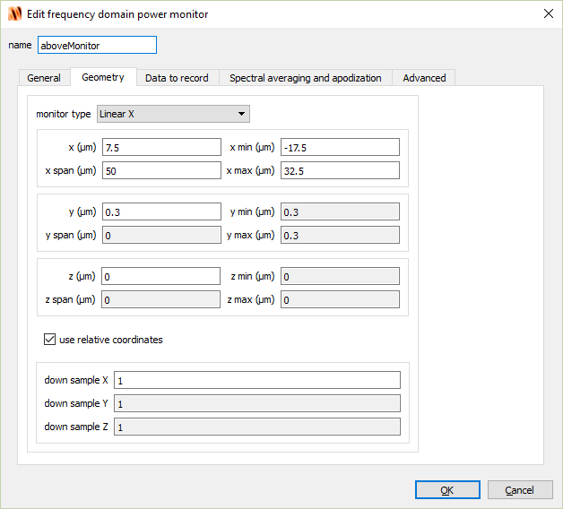
Field monitor above grating

Slide 14
Out-coupler simulation
Move the x-position of the waveguide source to -12.5µm and simulate.
Right-click on 2DMonitor and select Visualize→E
Notes:
~18s to finish

Slide 15
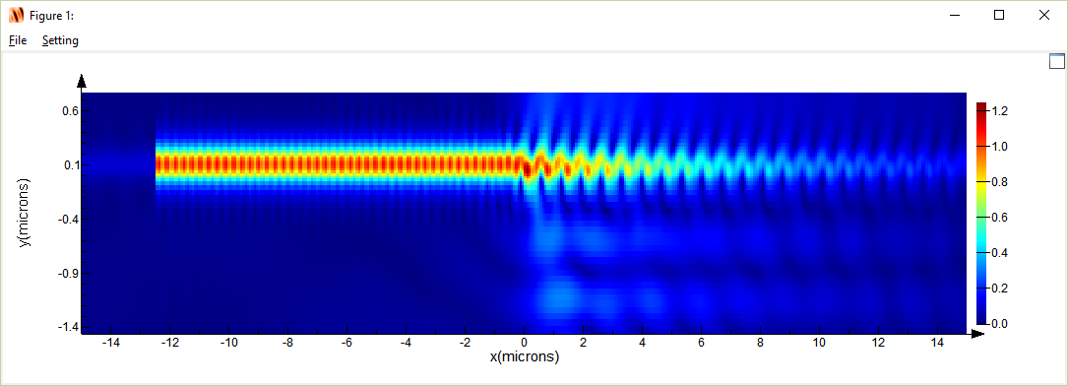
Power outcoupled
Light diffracted out of the grating
$$|E|$$
Light diffracted into the substrate
Go to Parameters box on bottom left
Select lambda, set scroll bar on right to near 1.55 um

Slide 16
Power outcoupled
Right-click on aboveMonitor and select Visualize→T

Slide 17
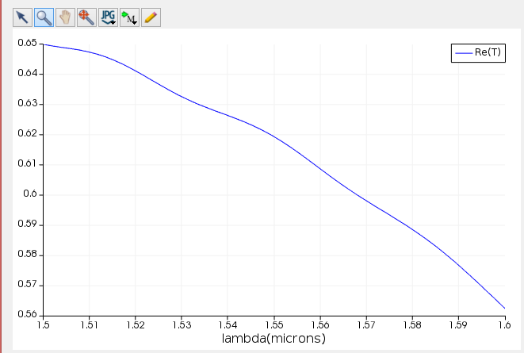
Power outcoupled
Our design is close but slightly off
Target wavelength

Slide 18
Grating angle sensitivity to wavelength
Right-click on aboveMonitor and select Visualize→ Farfield→ all

Slide 19
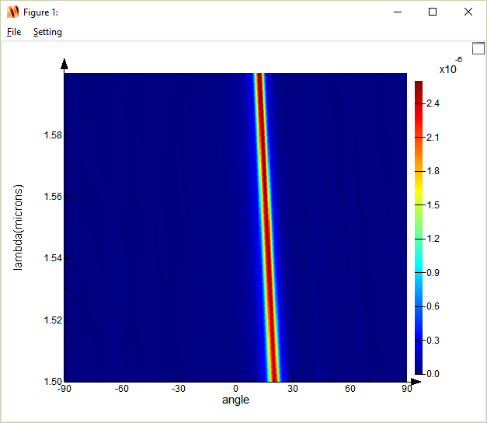
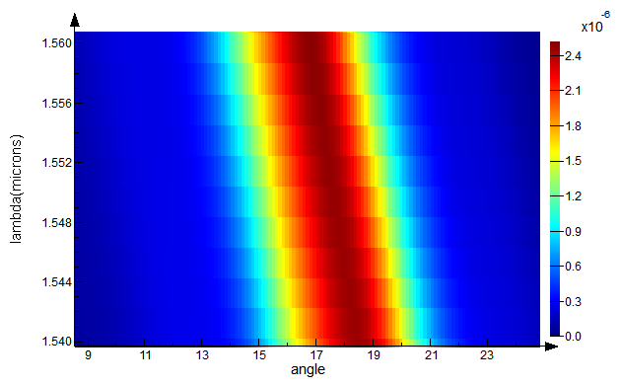
Grating angle sensitivity to wavelength
17.5° @ 1550 nm
(target 13°)

Slide 20
In-coupler grating design
Let’s see how well our grating coupler works for coupling light into a waveguide.
Go back to Layout mode
Right-click waveguide_source→Disable
Right-click source→Enable. This is a Gaussian source we will use first to approximate the fiber.

Slide 21
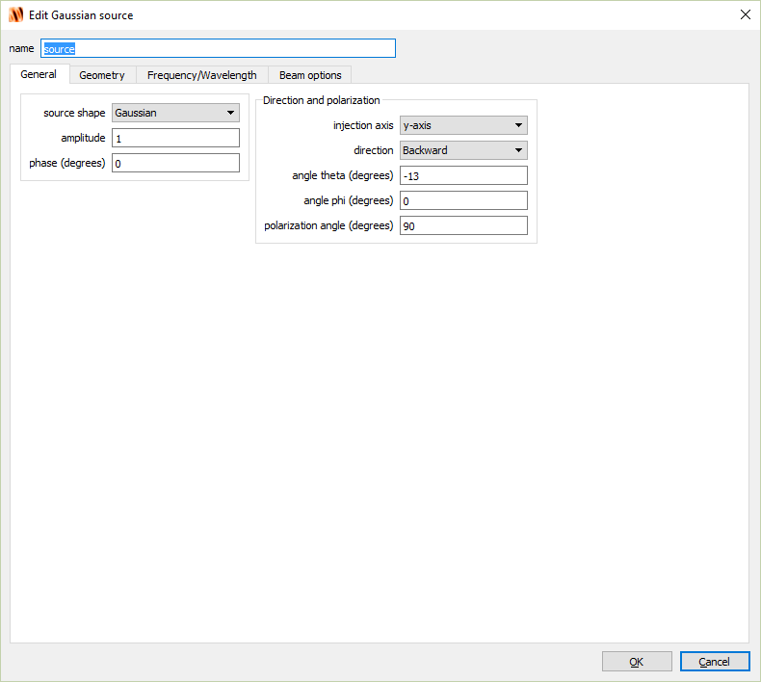
Gaussian source

Slide 22
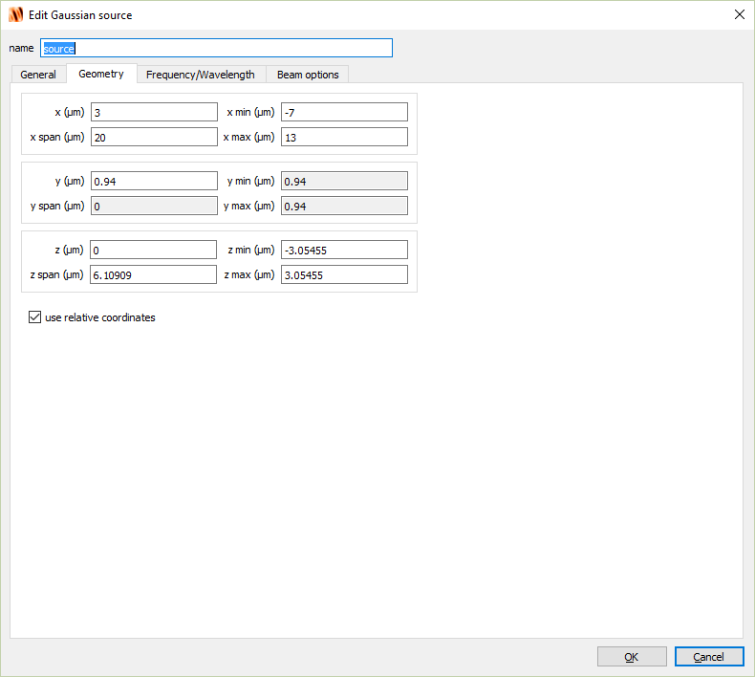
Gaussian source

Slide 23
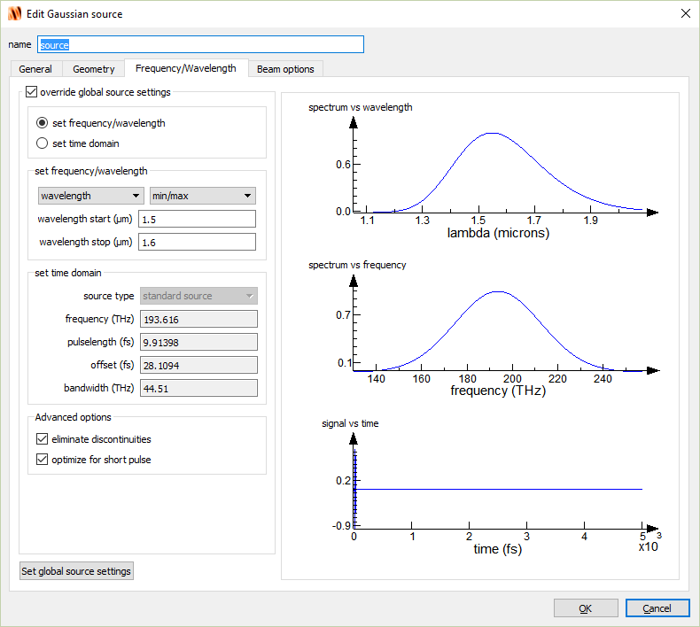
Gaussian source

Slide 24
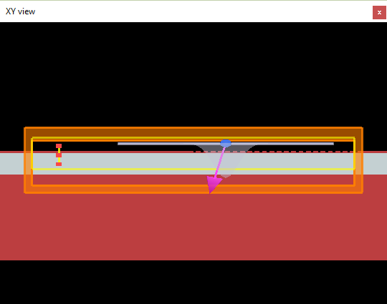
Power coupled into the waveguide
We will use modeMonitor to see the shape of the mode at various wavelengths
monitor

Slide 25
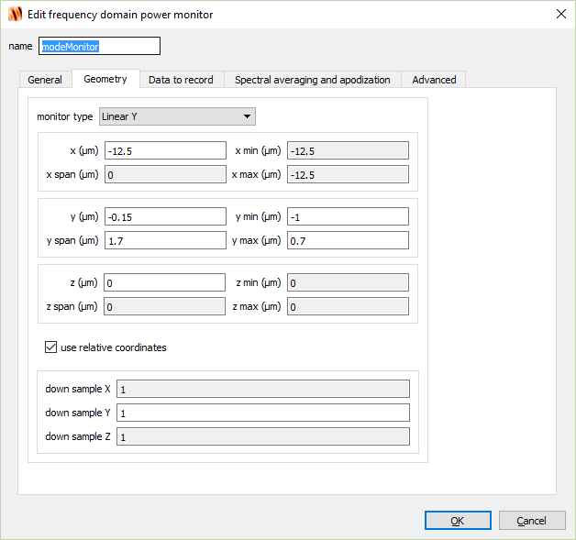
Power coupled into the waveguide

Slide 26
In-coupler grating simulation
Simulate
Right-click on 2DMonitor and select Visualize→E
Notes:
~8s to run

Slide 27
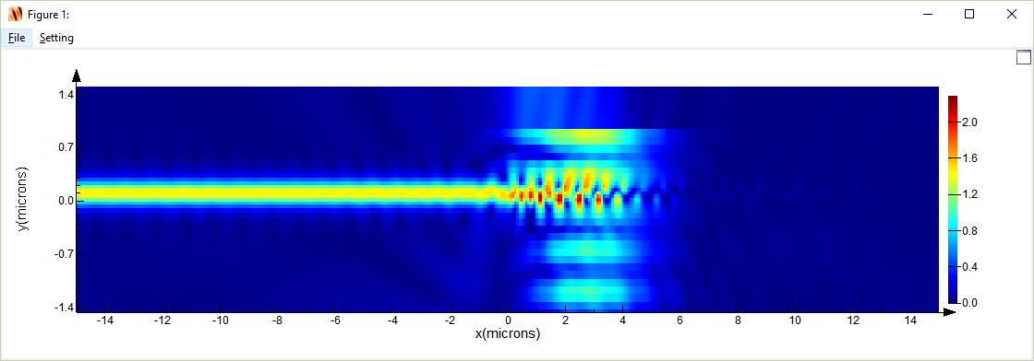
Power coupled into the waveguide
Power coupled into waveguide
Power lost into the substrate
Go to Parameters box on bottom left
Select lambda, set scroll bar on right to near 1.55 um

Slide 28
Mode monitor
Right-click on modeMonitor and select Visualize→T

Slide 29
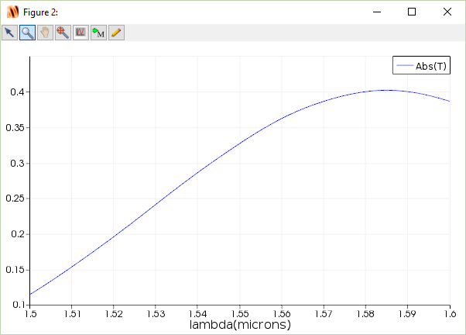
Power coupled into the waveguide
Again our “back of the envelope” design is slightly off, but not bad!
Target wavelength

Slide 30
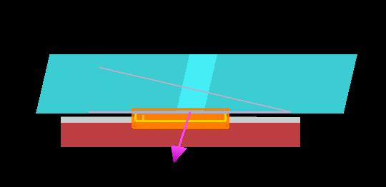
Fiber in-coupling to grating
Back to Layout mode
Disable source (Gaussian source)
Enable fiber analysis group
cladding
core
cladding

Slide 31
Pitch optimization
Using more realistic fiber geometry let’s optimize the grating pitch so that the coupling peaks at 1.55µm.
A sweep plan has already been generated called pitchSweep. This will sweep the pitch from 650nm to 700nm.
Run pitchSweep at home (this will run 20 simulations, ~3-4 min)
Right-click pitchSweep and select Visualize→ModeT

Slide 32
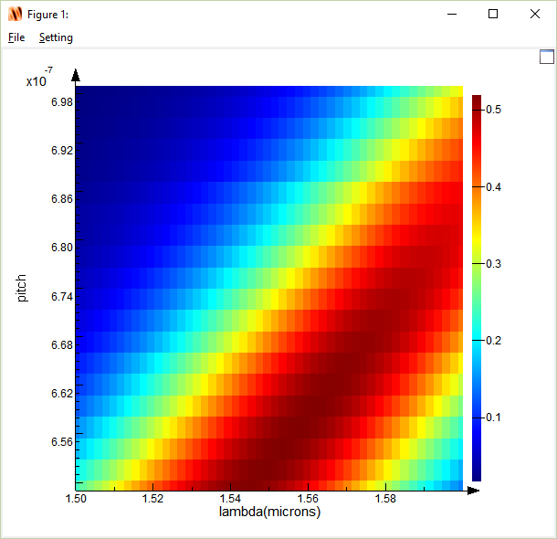
Pitch optimization
By choosing pitch of 653nm we can maximize the coupling at a wavelength of 1.55µm
* Need to do
Scalar operation→Abs again

Slide 33
Pitch optimization
Change grating_coupler_2D pitch to 653nm
Run simulation
Right-click on 2DMonitor and select Visualize→E

Slide 34
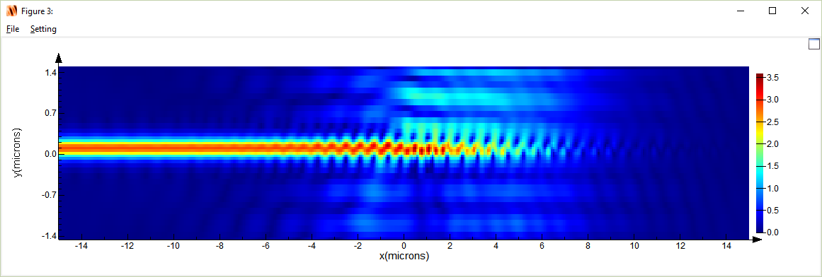
Pitch optimization
Power coupled into waveguide
Power lost into the substrate
Go to Parameters box on bottom left
Select lambda, set scroll bar on right to near 1.55 um

Slide 35
Mode monitor
Right-click on modeMonitor and select Visualize→T

Slide 36
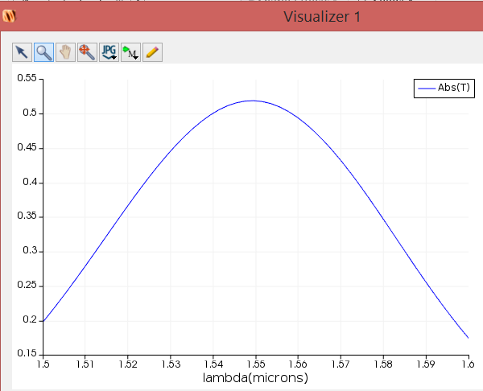
Pitch optimization
52% efficiency
Target wavelength

Slide 37
Position optimization
Coupling efficiency will be dependent upon the position of the fiber with respect to the grating
A sweep plan has been generated to sweep the fiber +/- 3 microns in the x-direction.
Note: It’s actually easier here to move the x-position of the grating but this accomplishes the same thing
Run xSweep at home (this will run 20 simulations)
Right-click xSweep and select Visualize→ModeT

Slide 38
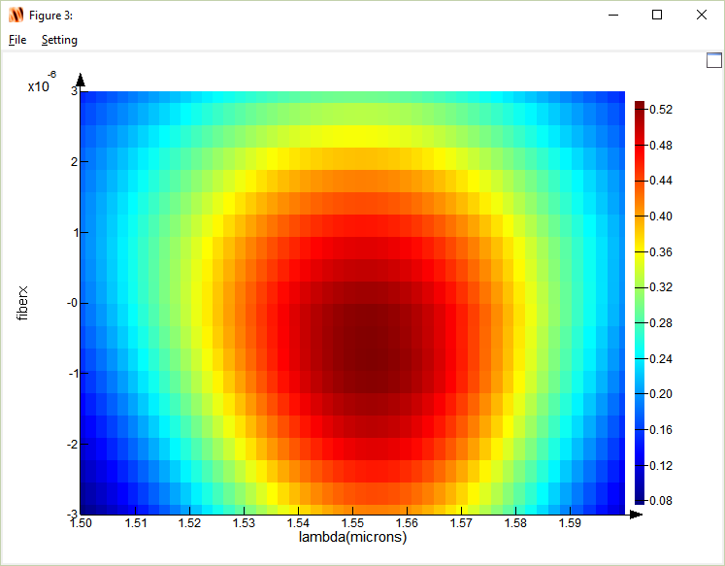
Position optimization
We can see here that we should shift our fiber
position by 0.5 micron to maximize coupling efficiency

Slide 39
Next discussion
Next discussion we will close the grating coupler topic by showing how to extract the grating S-parameters and how to import into the photonic circuit solver Lumerical Interconnect.
This will be particularly useful for the final project if you wish to simulate large structures.

